Slide 1
Text Game
Yiqi Sun

Slide 2
Inspiration
I usually get inspiration from everyday stuff
Since I go to school everyday, and now I am living in Weehawken , it is a necessary for me to find out any convenient public transportation means.
I was shocked when I first saw the instruction maps of subway,train, and bus
Notes:
But I think it is hard to figure out all the maps of subways, trains, bus.

Slide 3
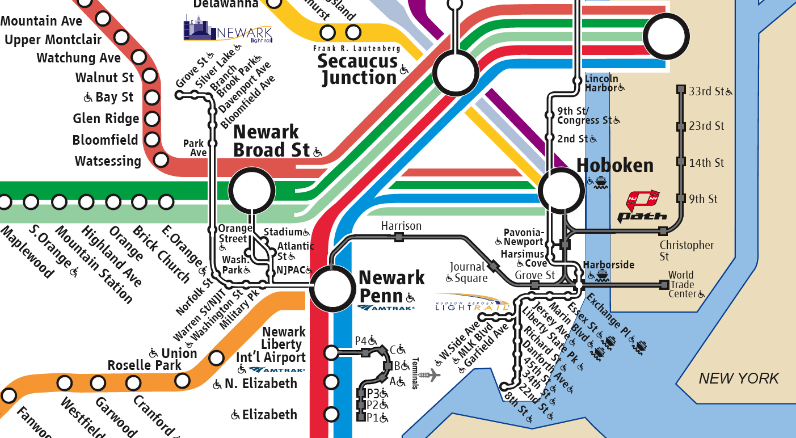
NJ Transit map
Notes:
You can see it is very puzzling.

Slide 4
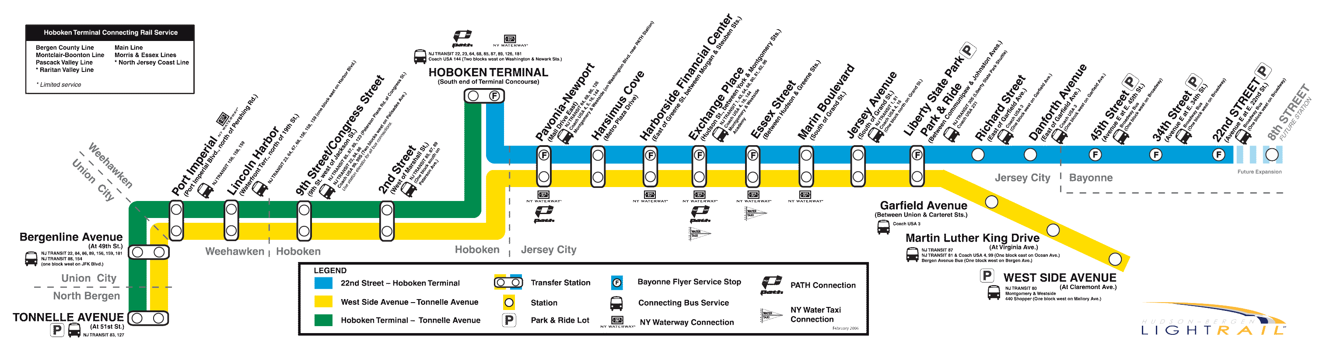
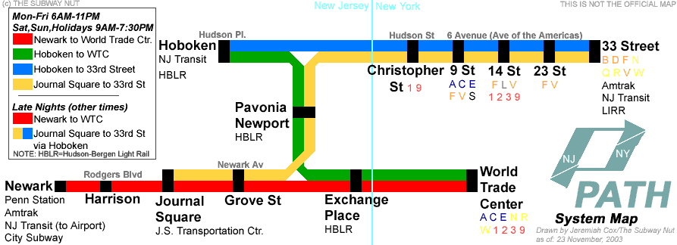
The two transportation means

Slide 5
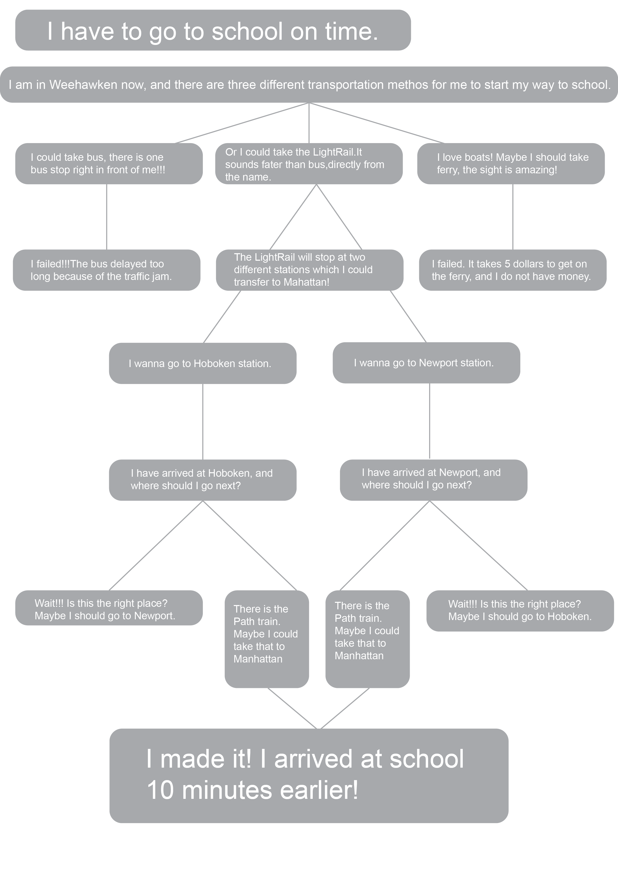
I have to go to school on time!!!

